Slide 1
Program
MineOperate Technical Level 1
Working with OP Pro Manager views
Edgar Sepulveda
Global Technical Manager, MineOperate
10/10/2022
Version 1.3

Slide 2

Purpose
This session …
​At the end of this module, you will:

Slide 3
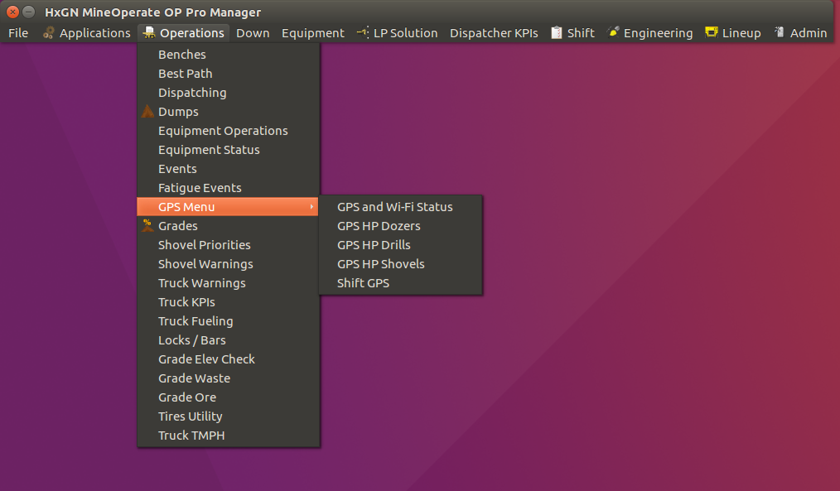
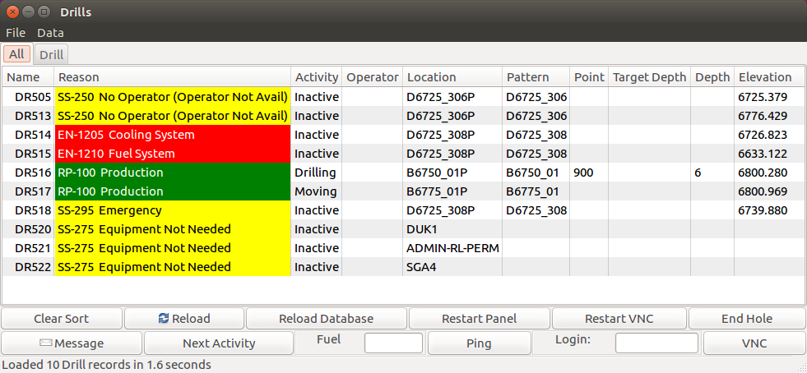
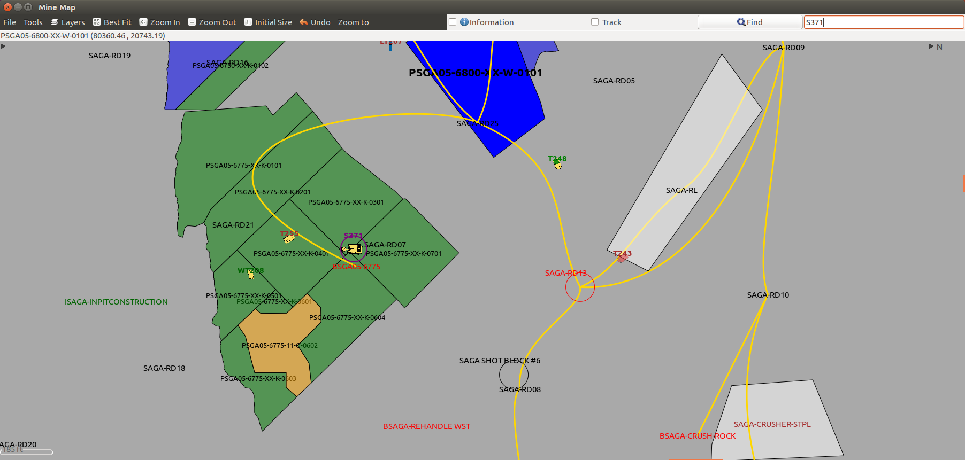
Working with OP Pro Manager views
View types
OP Pro Manager application uses three main view types which can be classified as:
Menus
Views
Applications

Slide 4
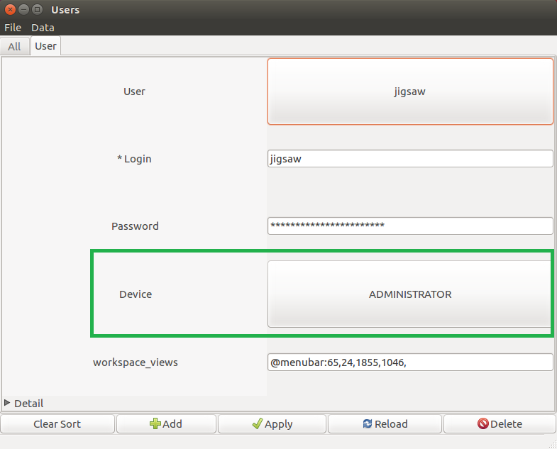
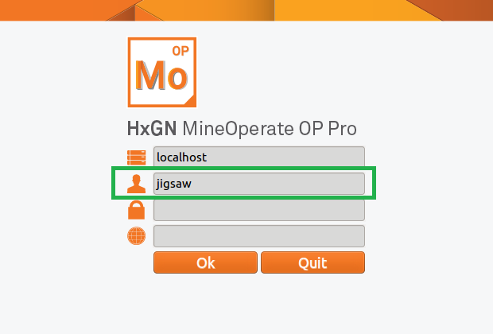
Working with OP Pro Manager views
Menus

Slide 5
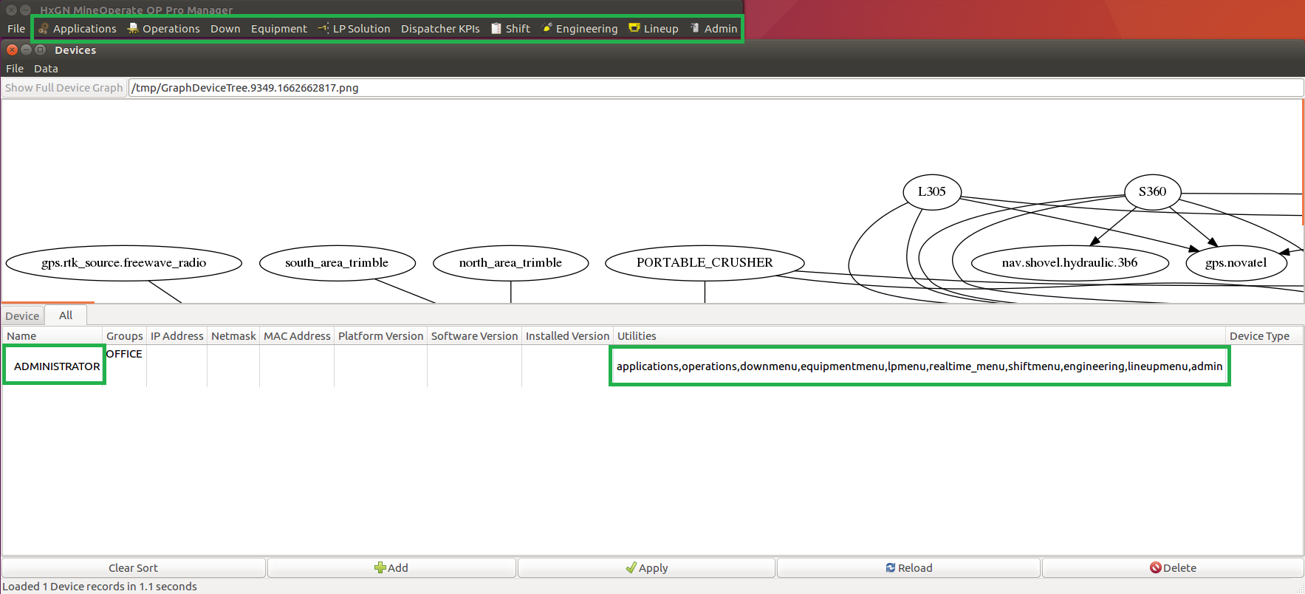
Working with OP Pro Manager views
Menus

Slide 6
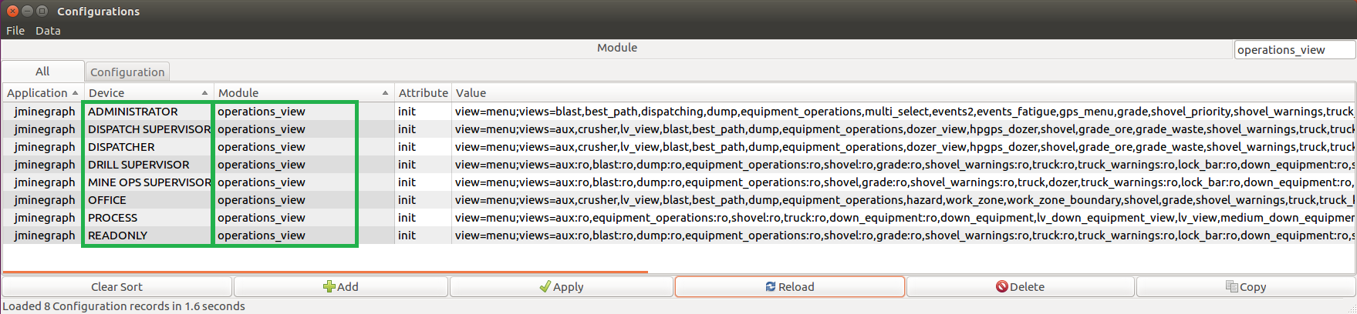
Working with OP Pro Manager views
Menus

Slide 7
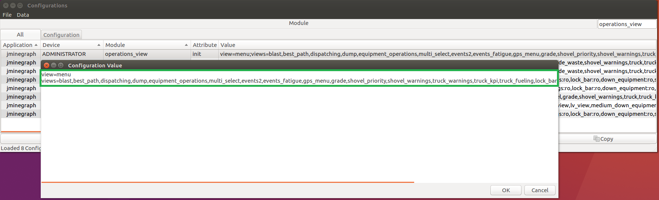
Working with OP Pro Manager views
Menus

Slide 8
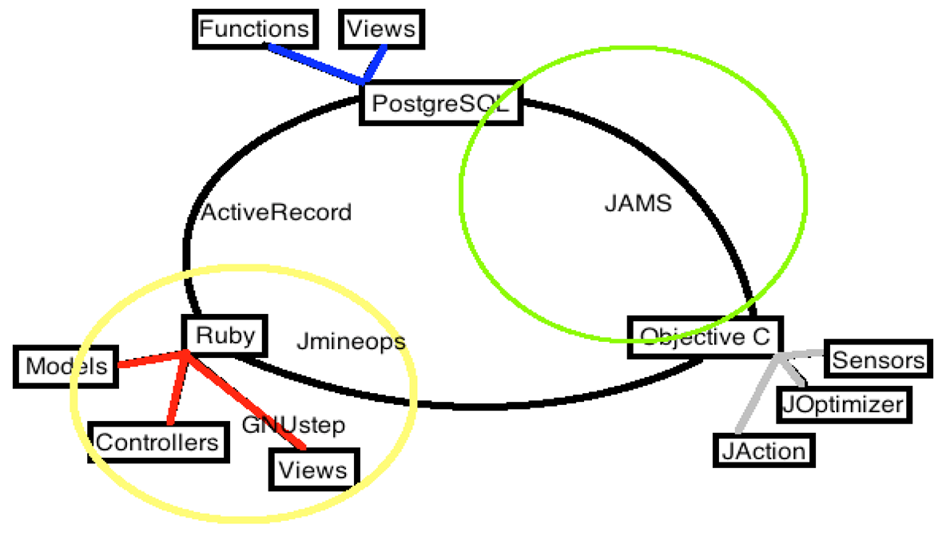
Working with OP Pro Manager views
Views

Slide 9
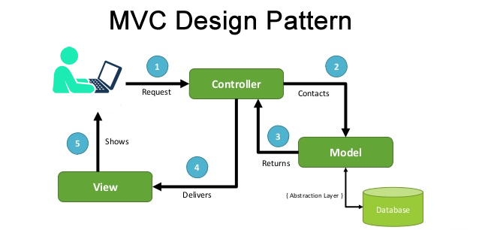
Working with OP Pro Manager views
Views
Model-View-Controller (MVC) is a software architectural pattern commonly used for developing user interfaces that divide the related program logic into three interconnected elements: Models, Views, and Controllers.

Slide 10
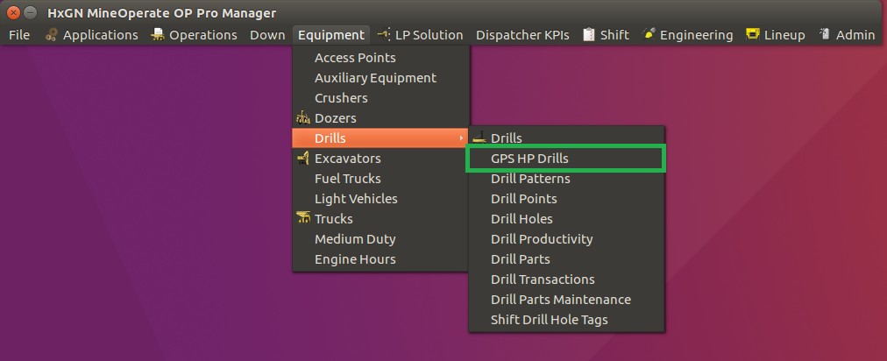
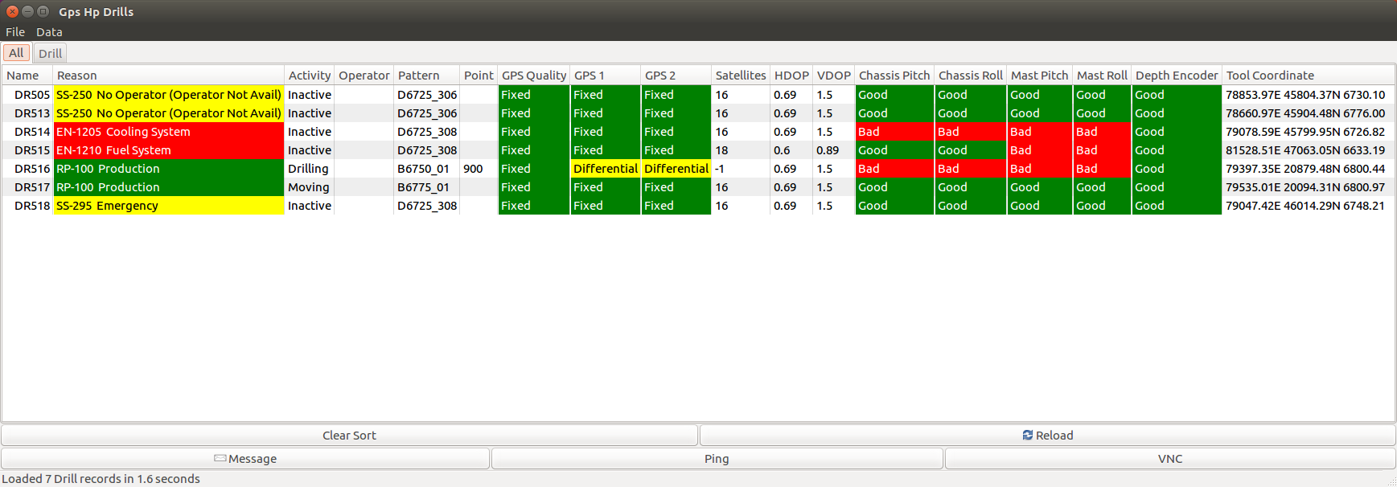
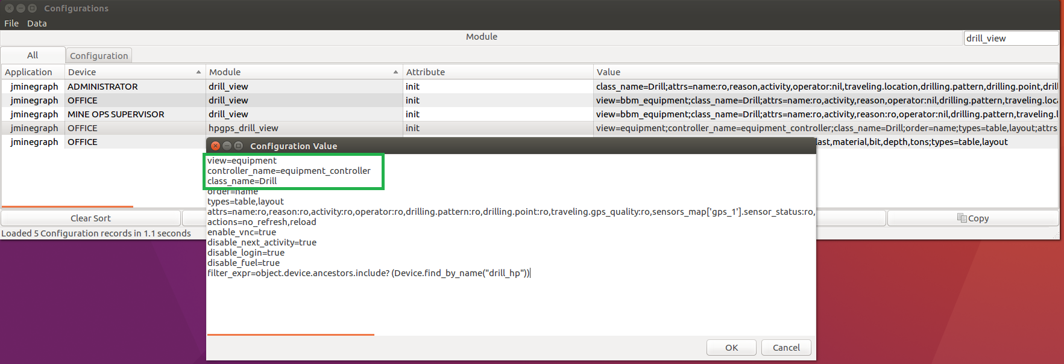
Working with OP Pro Manager views
Views

Slide 11
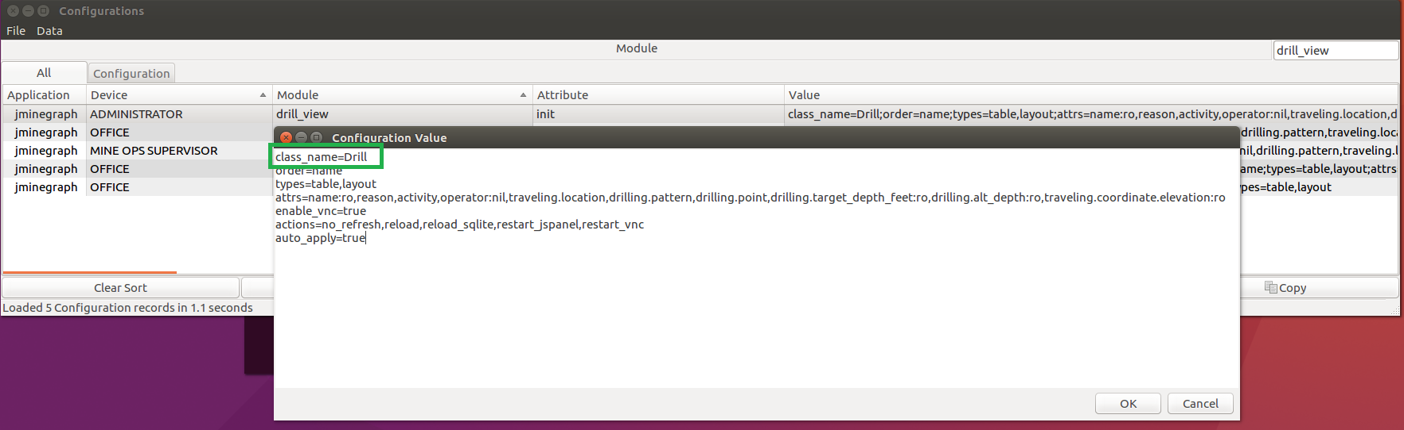
Working with OP Pro Manager views
Views
It looks for a view with same module name
If it does not find it then
view defaults to editor_view
view=editor
editor_view defaults to application_controller
controller_name=application_controller
view=editor
controller_name=application_controller
class_name=Drill

Slide 12
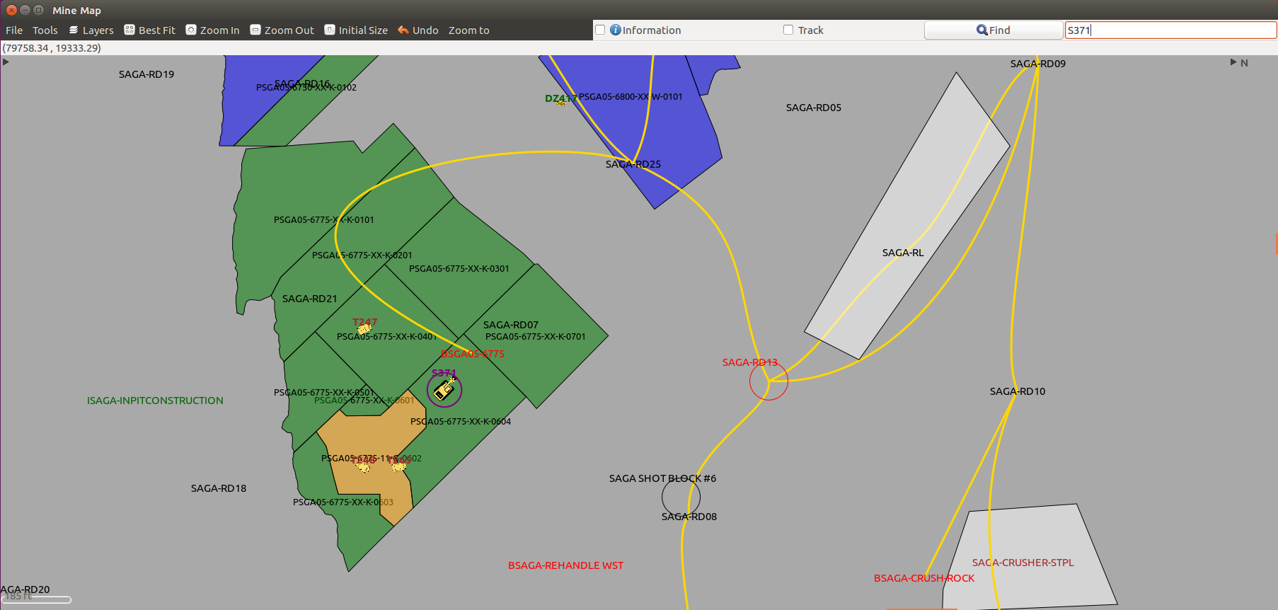
Working with OP Pro Manager views
Applications

Slide 13
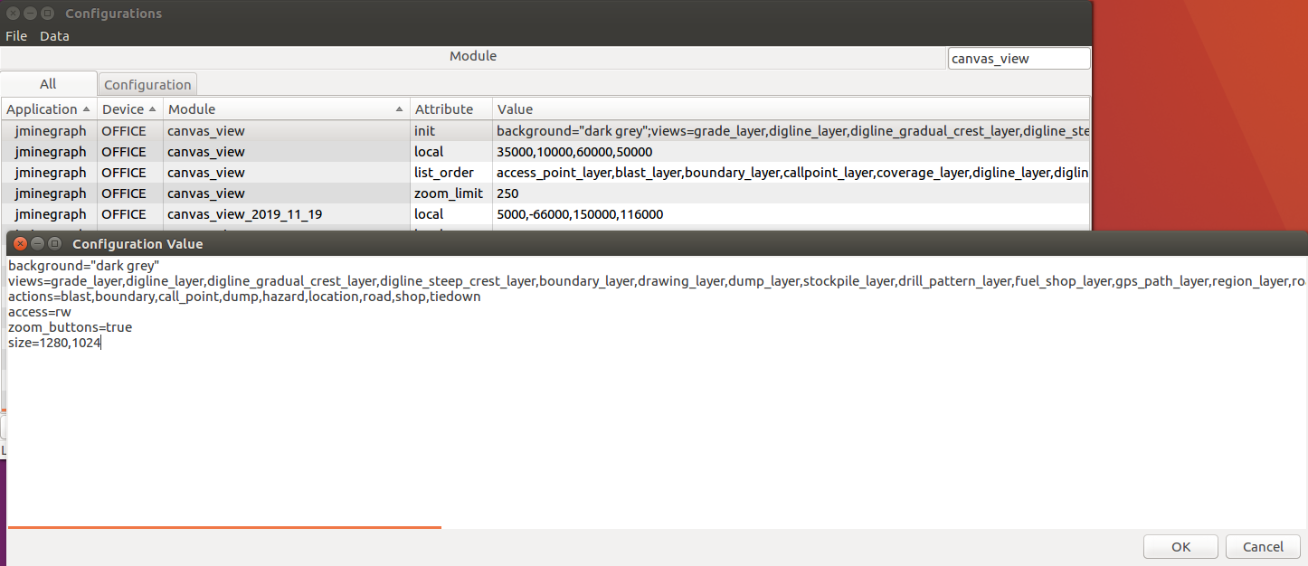
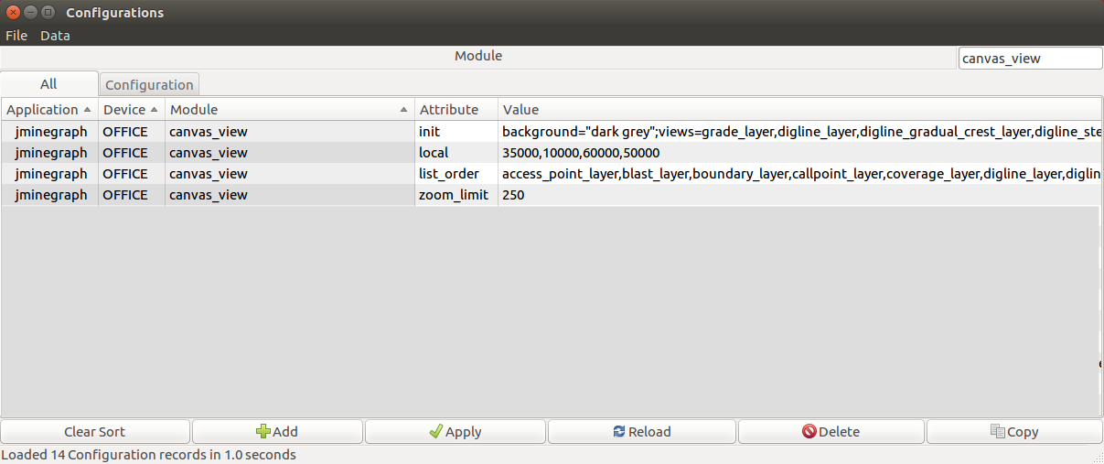
Working with OP Pro Manager views
Applications

Slide 14
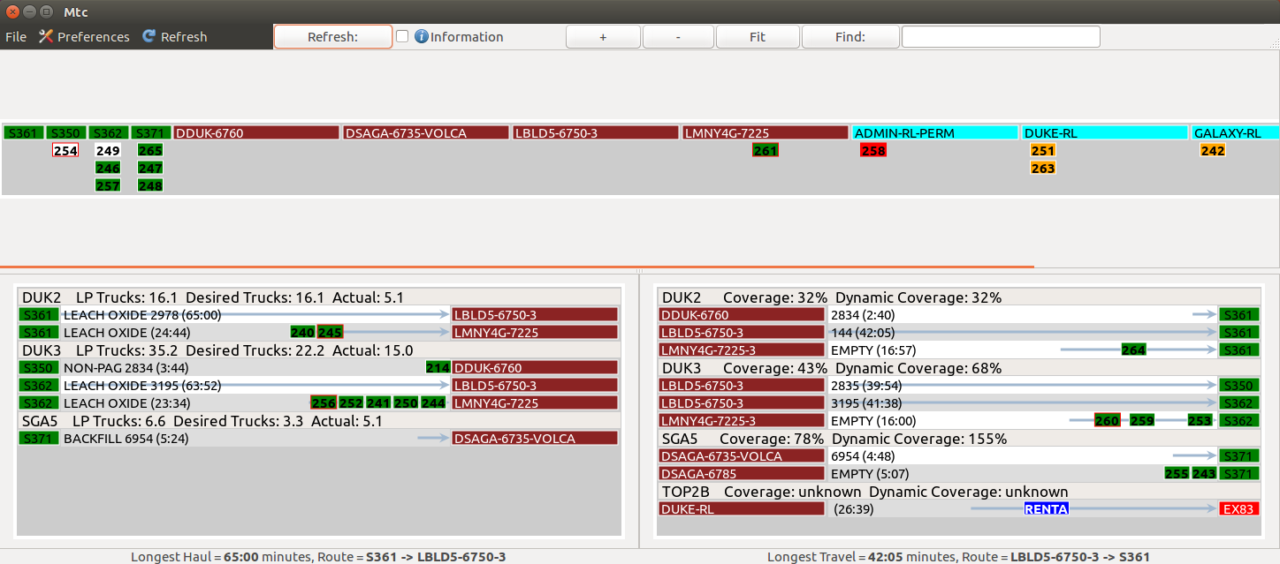
Working with OP Pro Manager views
Applications

Slide 15
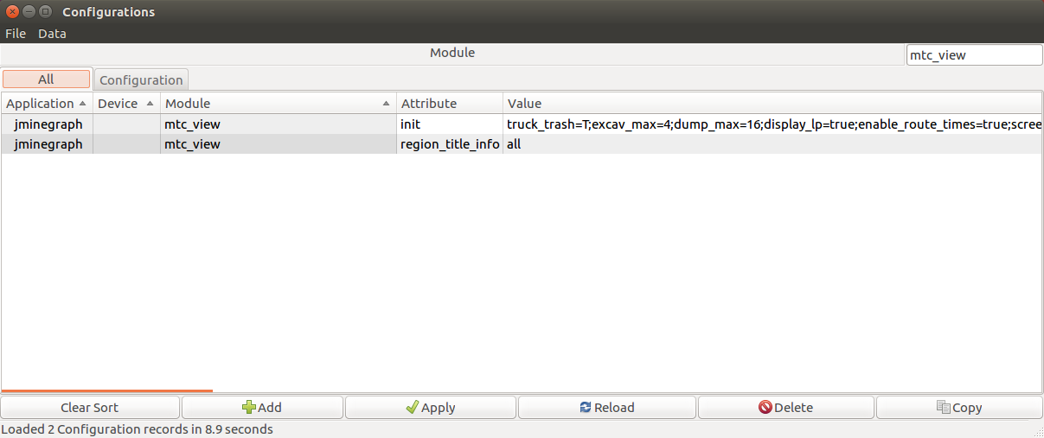
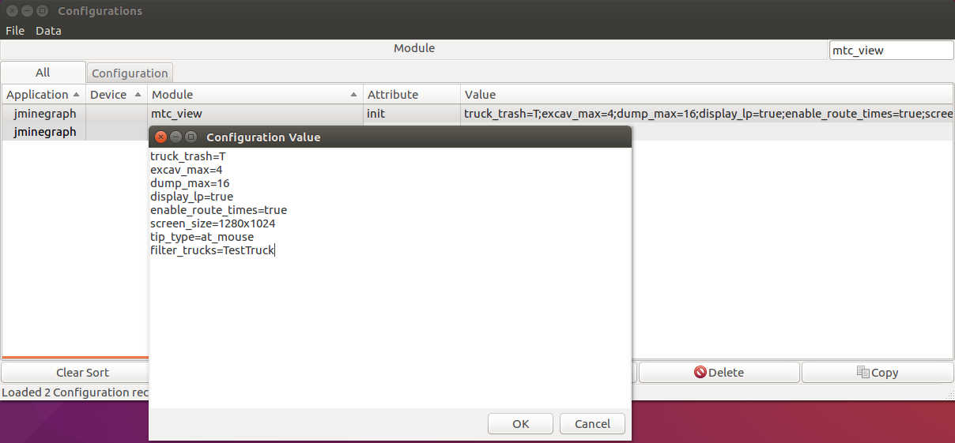
Working with OP Pro Manager views
Applications

Slide 16
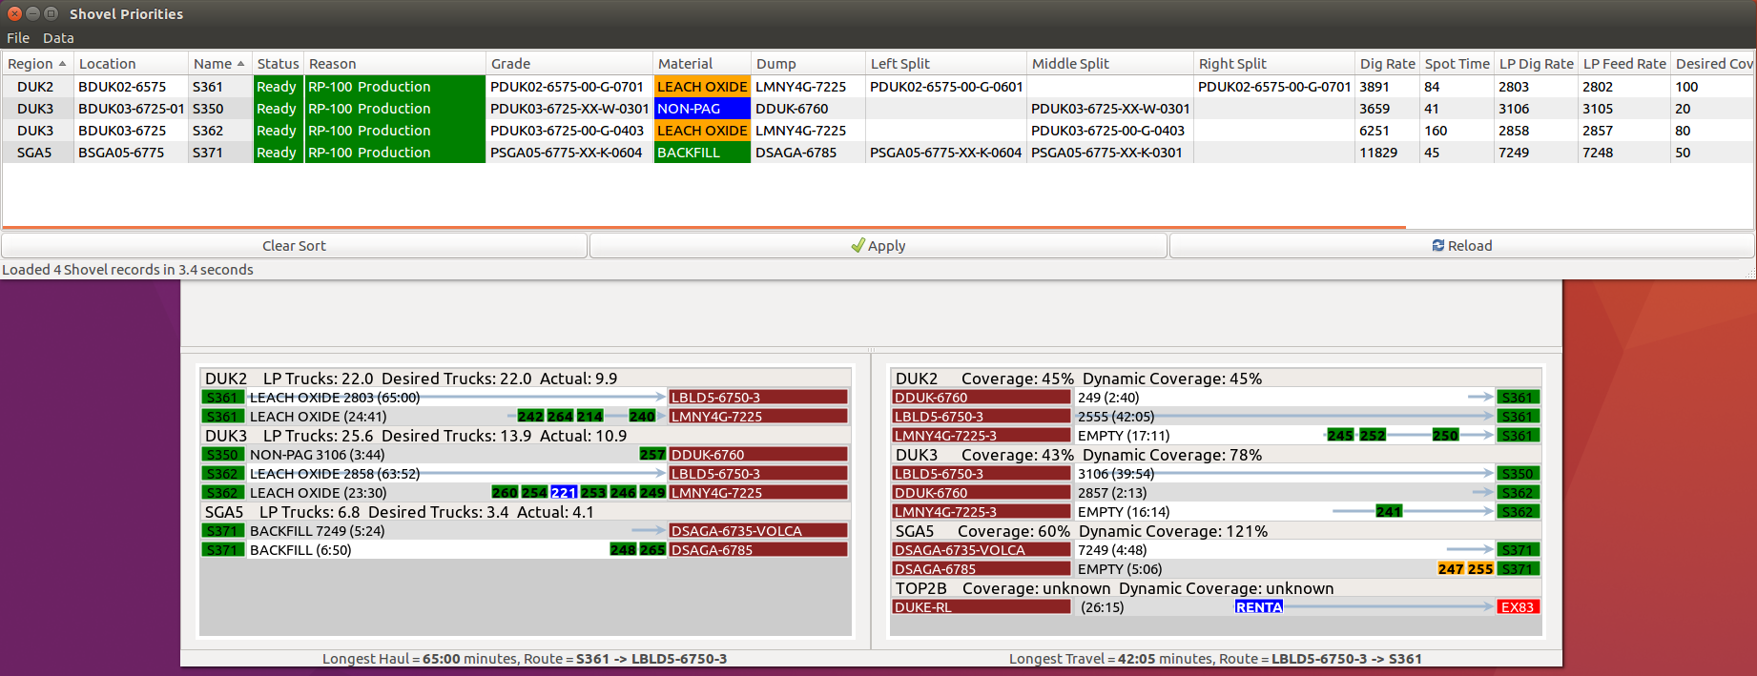
Working with OP Pro Manager views
Applications

Slide 17
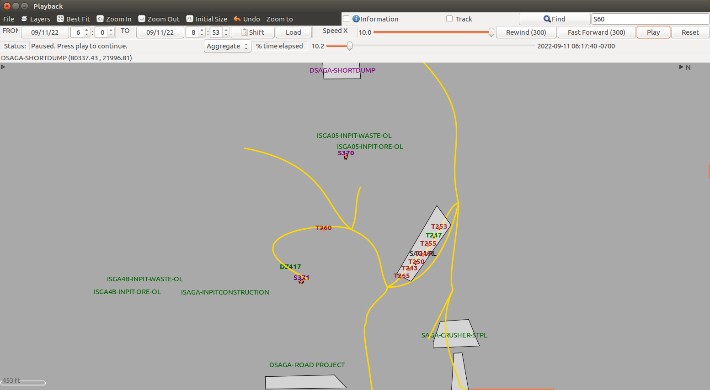
Working with OP Pro Manager views
Applications

Slide 18
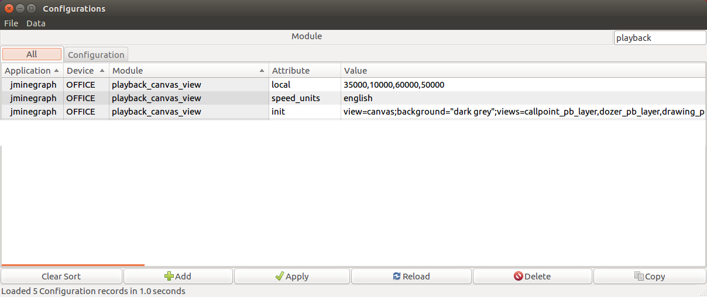
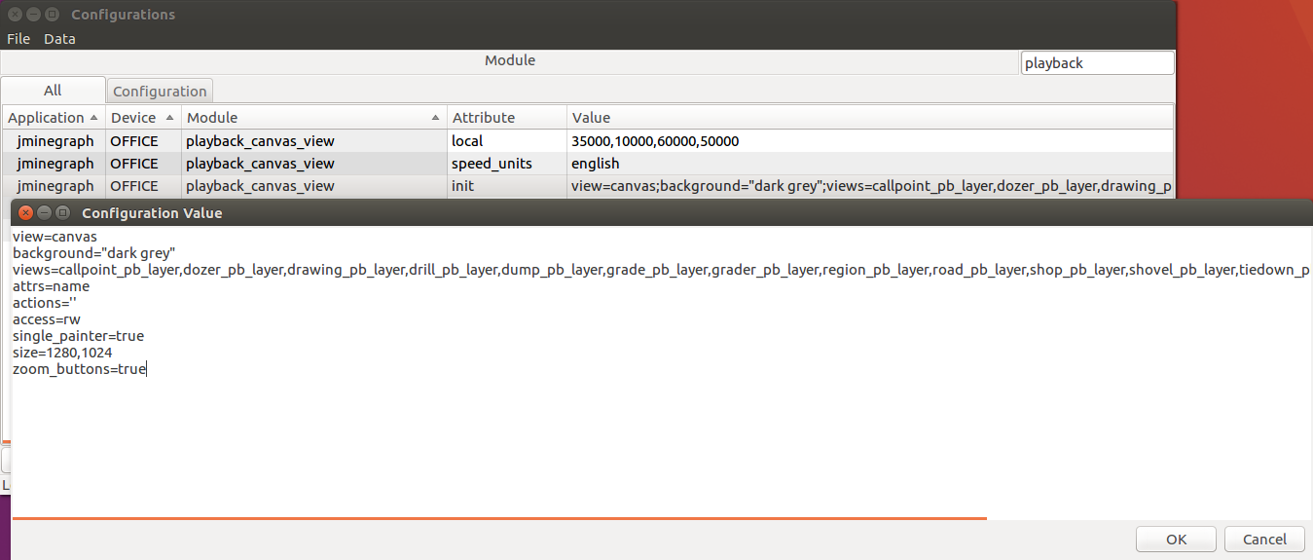
Working with OP Pro Manager views
Applications

Slide 19
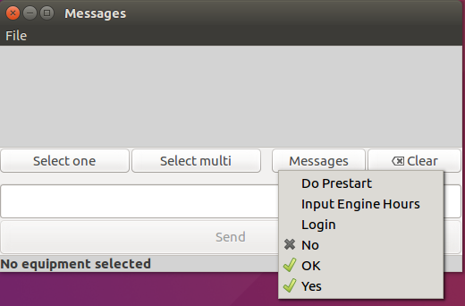
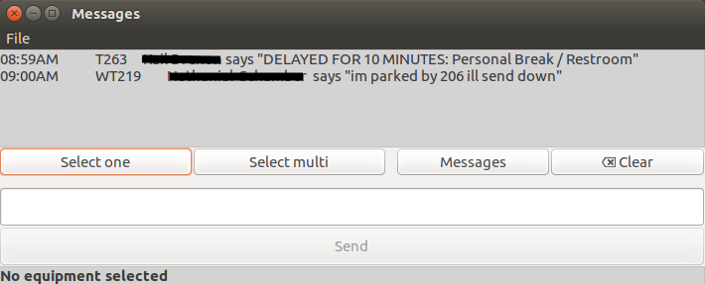
Working with OP Pro Manager views
Applications

Slide 20
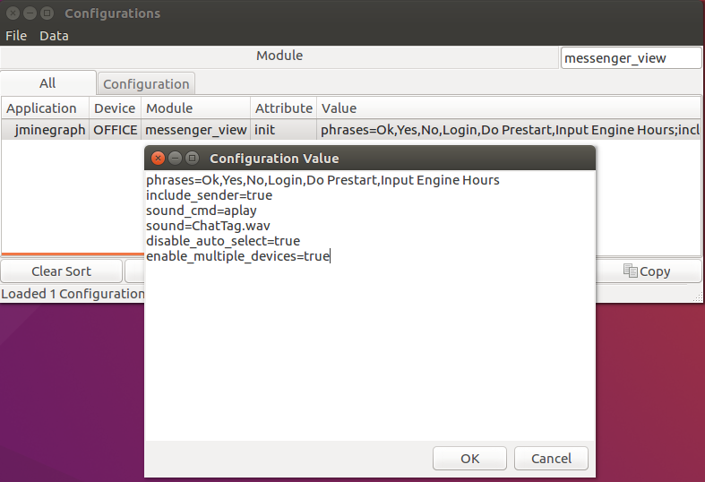
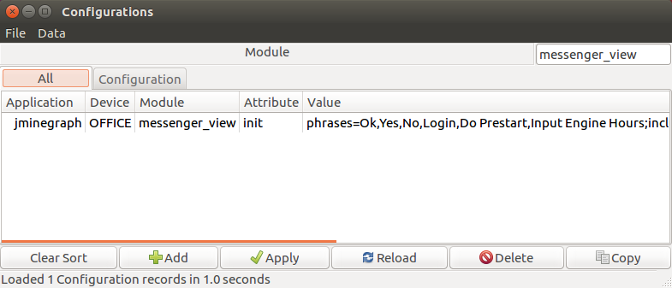
Working with OP Pro Manager views
Applications

Slide 21
Working with OP Pro Manager views - Questions

Slide 22
Working with OP Pro Manager views - Answers to Questions

Slide 23

THANK
Y
O
U

